Slide 1

Unit 4
Bending & Shear Stresses in Beams
School of Mechanical and Building Sciences
By
Dr. S.JEYANTHI
Professor

Slide 2
Outline
Introduction
Assumptions
Bending Equation
Problems

Slide 3
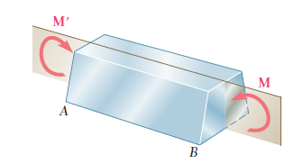
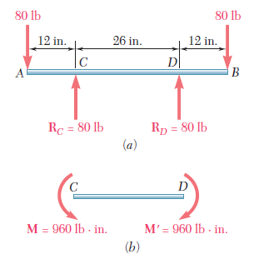
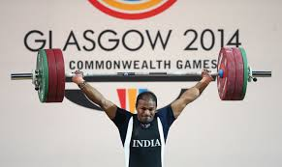
Introduction
If a member is subjected to equal and opposite couples acting in the same longitudinal plane, the member is said to be in pure bending.
Beam in which portion CD is in pure bending

Slide 4
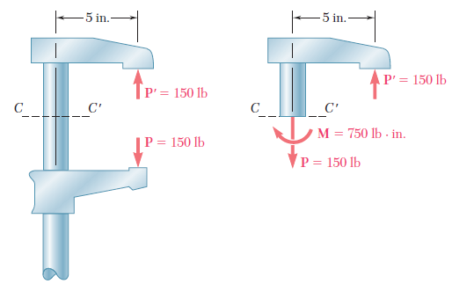
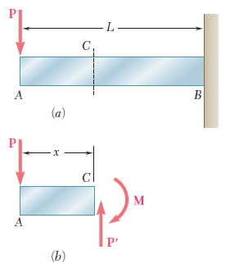
Bending is a major concept used in the design of many machine and structural components, such as beams and girders
Eccentric loading
Transverse loads

Slide 5
Assumptions
The material is homogeneous and isotropic
Transverse planes remain plane and perpendicular to the neutral surface after bending
The longitudinal filaments are bent into circular arcs with a common centre of curvature
The beam is symmetric about a vertical longitudinal plane passing through vertical axis of symmetry for horizontal beams
The stress is purely longitudinal and the stress concentration effects near the concentrated loads are neglected

Slide 6
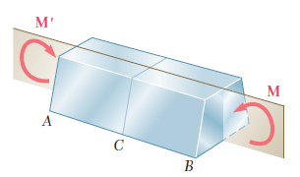
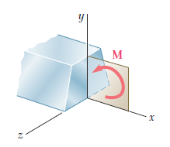
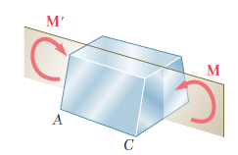
Symmetry
The internal forces in any cross section of a symmetric member in pure bending are equivalent to a couple

Slide 7
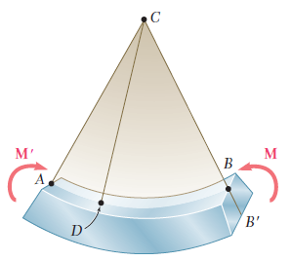

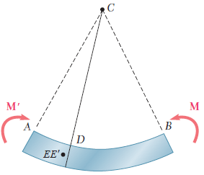
Circular Arcs with a Common Centre of Curvature
Transverse Planes Remain Plane after Bending
since the bending moment M is the same in any cross section, the member will bend uniformly

Slide 8
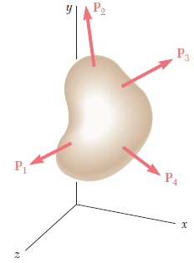
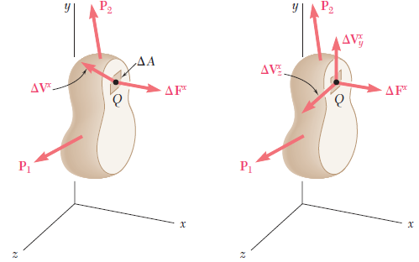
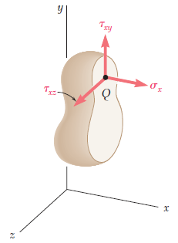
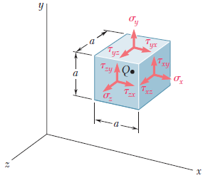
Stress is Purely Longitudinal

Slide 9
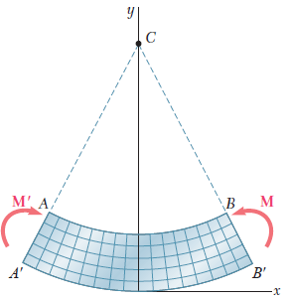
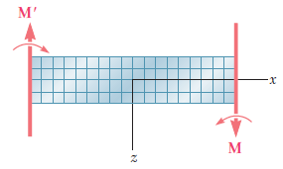
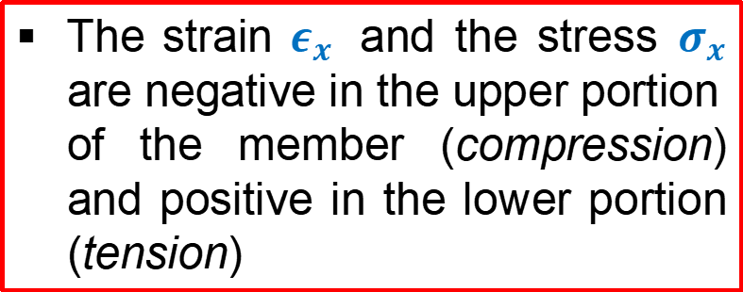
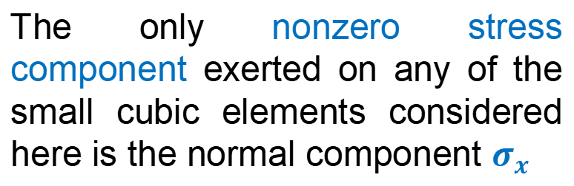

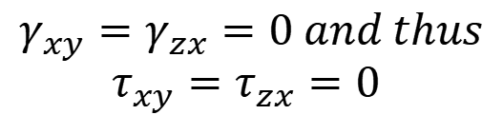
Since all the faces represented in the two projections of figure are at 90° to each other, we conclude that
$$γ_{xy}=γ_{zx}=0 and thus$$
$$τ_{xy}=τ_{zx}=0$$
$$σ_{y}=σ_{z}=τ_{yz}=0$$
The only nonzero stress component exerted on any of the small cubic elements considered here is the normal component $σ_{x}$
The strain $ε_{x}$ and the stress $σ_{x}$ are negative in the upper portion of the member (compression) and positive in the lower portion (tension)

Slide 10
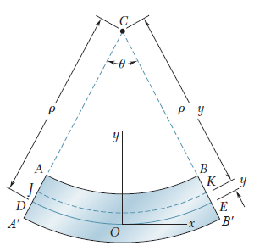
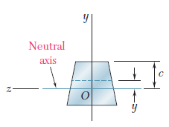
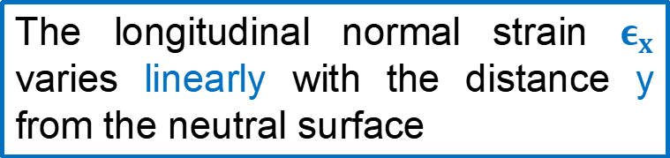
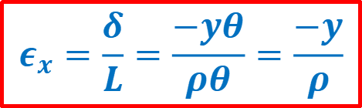
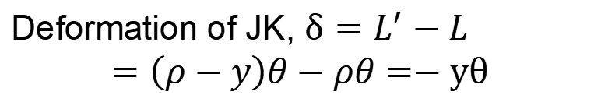


The surface where $ε_{x}$ and $σ_{x}$ are zero is called the neutral surface
Length of arc DE, $L=ρθ$
Length of arc JK, $L^{′}=\left(ρ−y\right)θ$
Deformation of JK, $δ=L^{′}−L$
$$=\left(ρ−y\right)θ−ρθ=−yθ$$
$$ε_{x}=\frac{δ}{L}=\frac{−yθ}{ρθ}=\frac{−y}{ρ}$$
The longitudinal normal strain $ε_{x}$ varies linearly with the distance y from the neutral surface

Slide 11


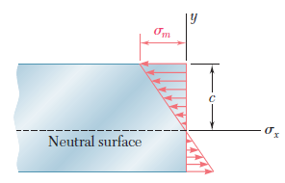


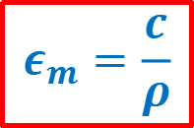
Let c be the largest distance from neutral axis, the maximum absolute value of strain
$$ε_{m}=\frac{c}{ρ}$$
Substitute for $ρ,$we get
Stress-strain relation of the material used,

Slide 12
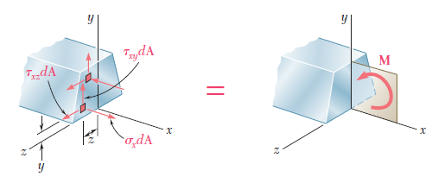
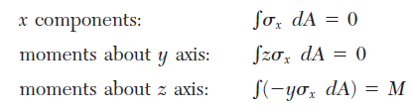

Slide 13


Location of the Neutral Axis
This equation shows that the first moment of the cross section about its neutral axis must be zero
In other words, for a member subjected to pure bending, and as long as the stresses remain in the elastic range, the neutral axis passes through the centroid of the section.

Slide 14







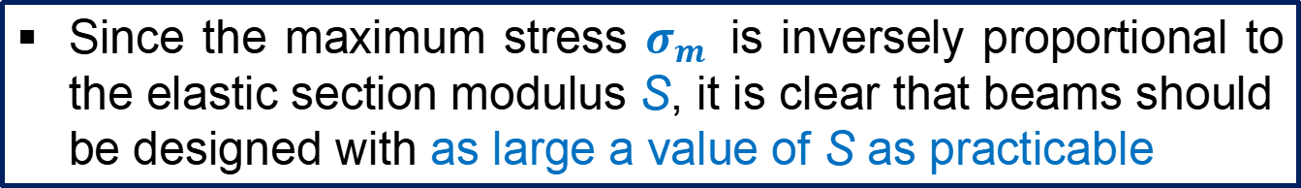
Elastic Flexure Formulas
Since the maximum stress $σ_{m}$ is inversely proportional to the elastic section modulus S, it is clear that beams should be designed with as large a value of S as practicable

Slide 15

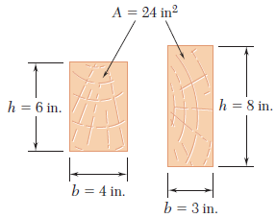
Example
For example, in the case of a wooden beam with a rectangular cross section of width b and depth h, we have
This shows that, of two beams with the same cross-sectional area A, the beam with the larger depth h will have the larger section modulus and, thus, will be the more effective in resisting bending

Slide 16

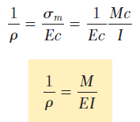
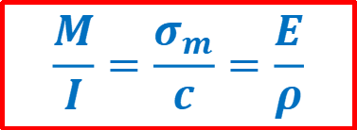
Moment-Curvature Relationship
$$ε_{m}=\frac{c}{ρ}$$
Reciprocal of radius of curvature is known as curvature
EI – Flexural rigidity of the beam
Flexural rigidity is a measure of the resistance of a beam to bending, that is, the larger the flexural rigidity, the smaller the curvature for a given bending moment
$$\frac{M}{I}=\frac{σ_{m}}{c}=\frac{E}{ρ}$$

Slide 17
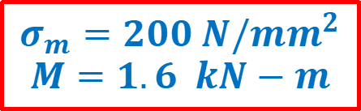
Problem 1
A steel plate of width 120 mm and of thickness 20 mm is bent into a circular arc of radius 10 m. Determine the maximum stress induced and the bending moment which will produce the maximum stress. Take E = 2 x 10⁵ N/mm².
$$σ_{m}=200 N/{mm}^{2}$$
$$M=1.6 kN−m$$

Slide 18
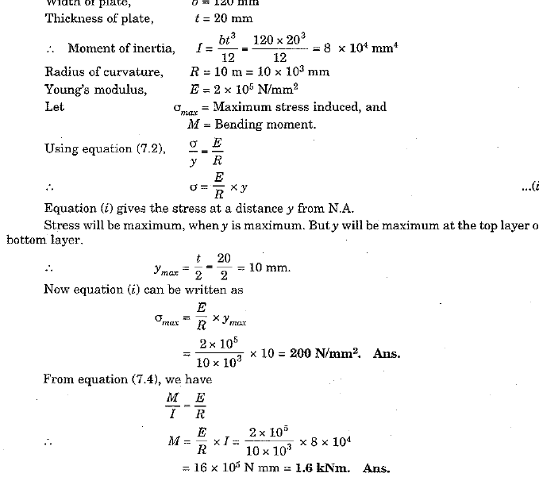

Slide 19


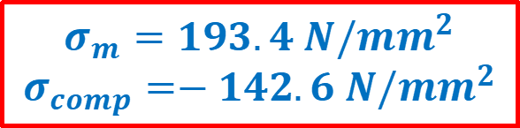
Problem 2
An aluminum rod with a semicircular cross section of radius r = 12 mm shown in figure is bent into the shape of a circular arc of mean radius ρ = 2.5 m. Knowing that the flat face of the rod is turned toward the center of curvature of the arc, determine the maximum tensile and compressive stress in the rod. Use E = 70 GPa.
$$σ_{m}=193.4 N/{mm}^{2}$$
$$σ_{comp}=−142.6 N/{mm}^{2}$$

Slide 20
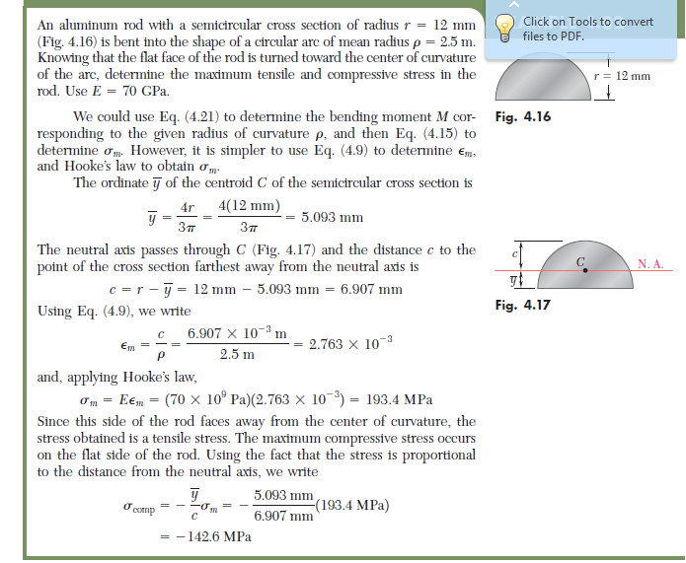

Slide 21
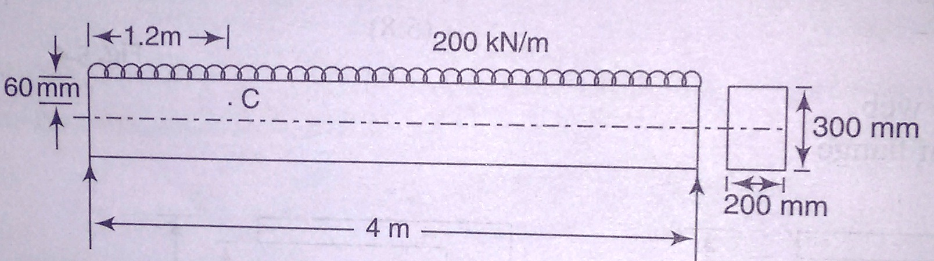

Problem 3
Figure shows a simply supported 200-mm wide, 300-mm deep and 4-m long beam. Determine the bending stress at the point C which is 60 mm below the top surface and 1.2 m from the left support.
$$σ_{b}=67.2 N/{mm}^{2}$$

Slide 22
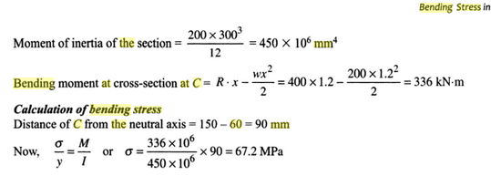

Slide 23
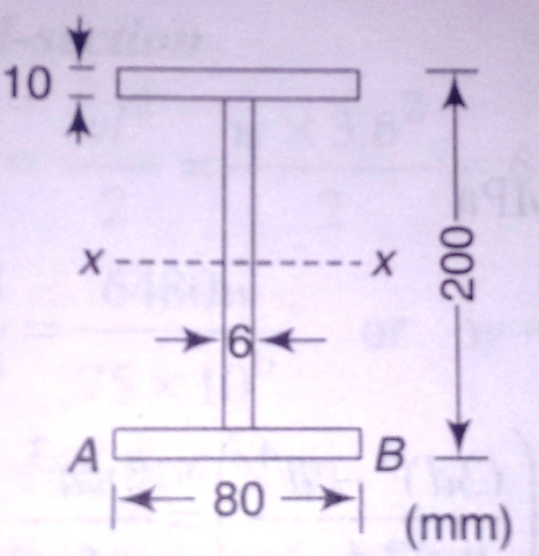

Problem 4
A 200 mm x 80 mm I-beam is to be used as a simply supported beam of 6.75 m span. The web thickness is 6 mm and the flanges are of 10-mm thickness. Determine what concentrated load can be carried at a distance of 2.25 m from one support if the maximum permissible stress is 80 MPa.
$W=9.264$ kN

Slide 24
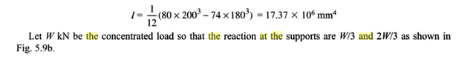
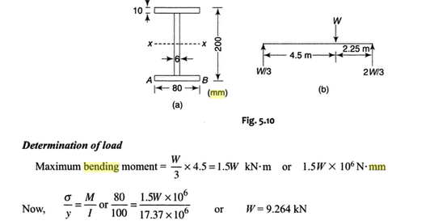

Slide 25
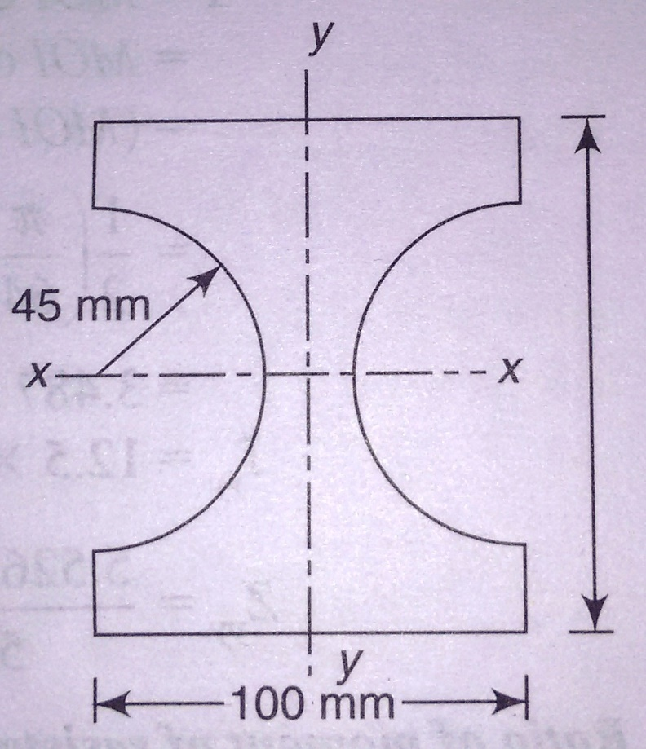
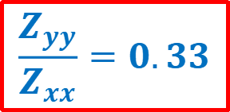
Problem 5
Figure shows the section of a beam. Determine the ratio of its moment of resistance to bending in the y-y plane to that in the x-x plane if the maximum bending stress remains same in the two cases.
$$\frac{Z_{yy}}{Z_{xx}}=0.33$$

Slide 26
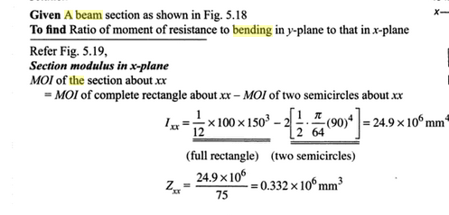
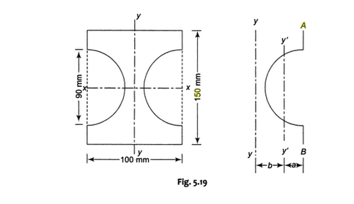

Slide 27
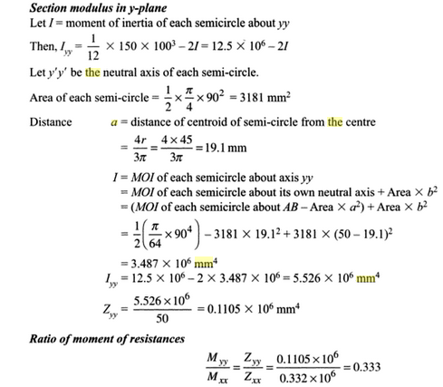

Slide 28
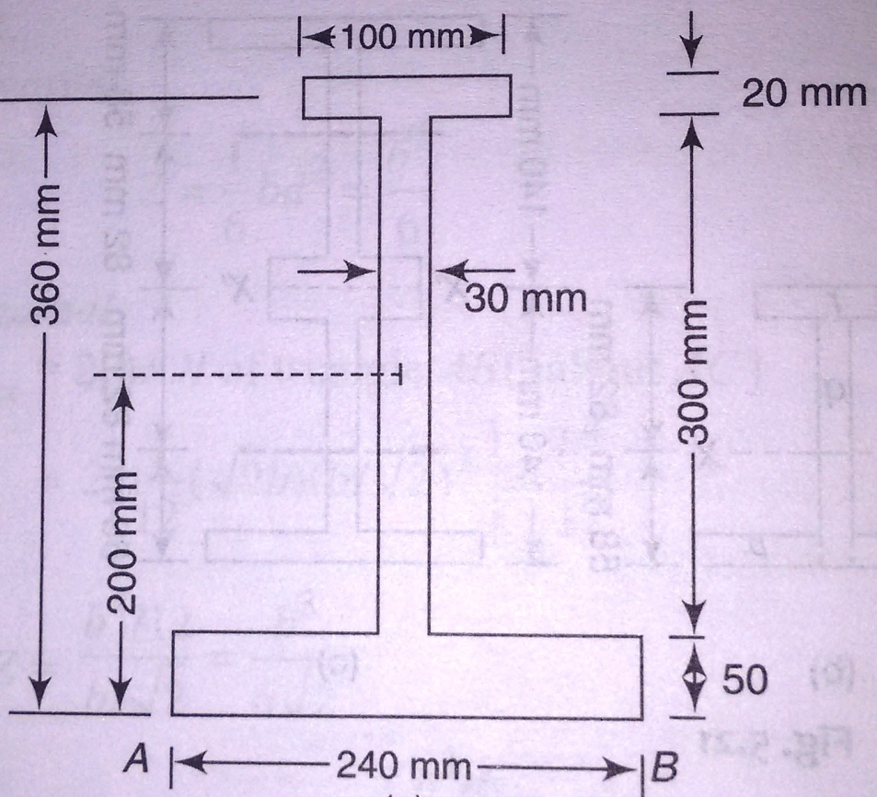

Problem 6
The tension flange of a cast iron I-section beam is 240 mm wide and 50 mm deep, the compression flange is 100 mm wide and 20 mm deep whereas the web is 300 mm x 30 mm. Find the load per m run which can be carried over a 4 m span by a simply supported beam if the maximum permissible stresses are 90 MPa in compression and 24 MPa in tension.
$w=34.36$kN/m

Slide 29
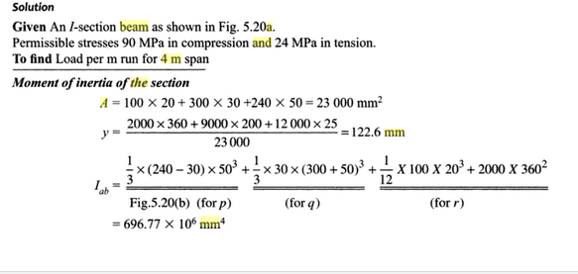

Slide 30
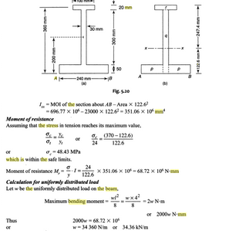

Slide 31
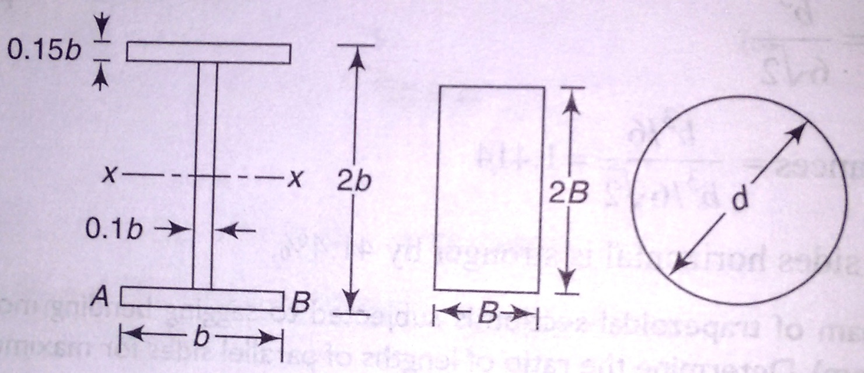


Problem 7
Compare the flexure strength of three beams of equal weight with the following specifications:
I-section with length of web, thickness of each flange and the thickness of web in terms of width of b of the flanges being 1.7b, 0.15b and 0.1b respectively.
Rectangular section of depth equal to twice the width
Solid circular section
$$\frac{Z_{1}}{Z_{2}}=3.926$$
$$\frac{Z_{1}}{Z_{3}}=6.561$$

Slide 32




Problem 8
A cast-iron machine part is acted upon by the 3 kN-m couple shown. Knowing that E = 165 GPa and neglecting the effect of fillets, determine (a) the maximum tensile and compressive stresses in the casting, (b) the radius of curvature of the casting.

Slide 33


Slide 34




Slide 35


Slide 36


Slide 37


Slide 38


Slide 39


Slide 40
Shear Stresses in Beams

Slide 41




Assumptions
The shear stresses $τ$acting on the cross section are parallel to the shear force
The shear stresses are uniformly distributed across the width of the beam, although they may vary over the height
$$τ=0 at y=±\frac{h}{2}$$

Slide 42

Each beam will be in compression above its own neutral axis and in tension below its neutral axis
Therefore the bottom surface of the upper beam will slide with respect to the top surface of the lower beam
When this beam is glued and loaded, horizontal shear stresses must develop along the glued surface in order to prevent the sliding
Because of the presence of these shear stresses, the single solid beam is much stiffer and stronger than the two separate beams

Slide 43





Derivation of Shear Formula

Slide 44



Slide 45


Slide 46


Slide 48


Slide 49


Slide 50


Slide 51


Slide 52


Slide 53


Slide 54


Slide 55


Slide 56


Slide 57


Slide 58


